Slide 1
Philosophy, Ethics, and Safety of AI
Session 17

Slide 2
Learning Outcomes
Session 17
At the end of this session, students will be able to:
LO 6: Analyze the impact of AI in society concerning ethical, fairness, and safety issues

Slide 3
Outline
Session 17
What is Ethics
AI and people
Long-Term Ethical Problems in AI
Near-Term Ethical Problems in AI
Topic on Ethical AI
Best Practices

Slide 4
What is Ethics?

Slide 5
What is ethics
Definition
Ethics ≠ Feelings
Ethics ≠ Societal Beliefs
Ethics ≠ Laws

Slide 6
What is ethics
Definition
Ethics is a study of what are good and bad ends to pursue in life and what it is right and wrong to do in the conduct of life
Its primary aim is to determine how one ought to live and what actions one ought to do in the conducts of one’s life

Slide 7
What is ethics
Definition
It’s the good things
It’s the right things

Slide 8
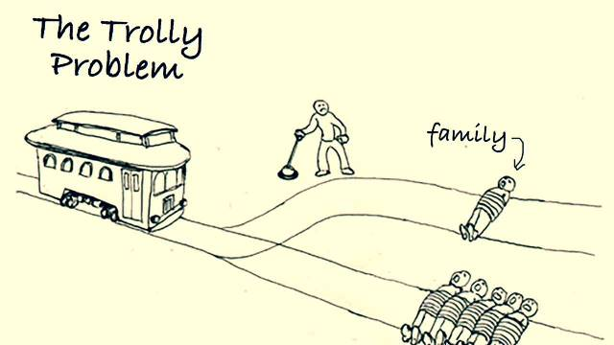
What is ethics
Trolley problem

Slide 9
What is ethics
IQ Dillema
We can train a model to predict people’s IQ from their photos and text. Let’s discuss whether it is ethical to build such a technology and what are the risks.
  Who could benefit from such a classifier?
  Who can be harmed from such a classifier? How can it be misused?
  What are the pitfalls/risks in the current solution?
  Who is responsible?

Slide 10
AI and People

Slide 11
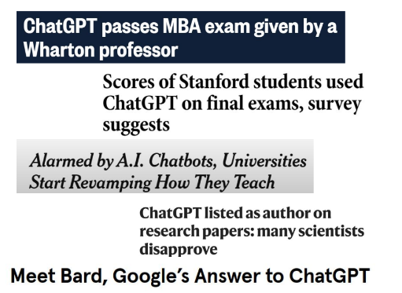
AI and People
The current Problem

Slide 12
AI and People
The ethical question
What are important ethical questions to ask in
development and deployment of AI systems?

Slide 13
Long Term Problem

Slide 14
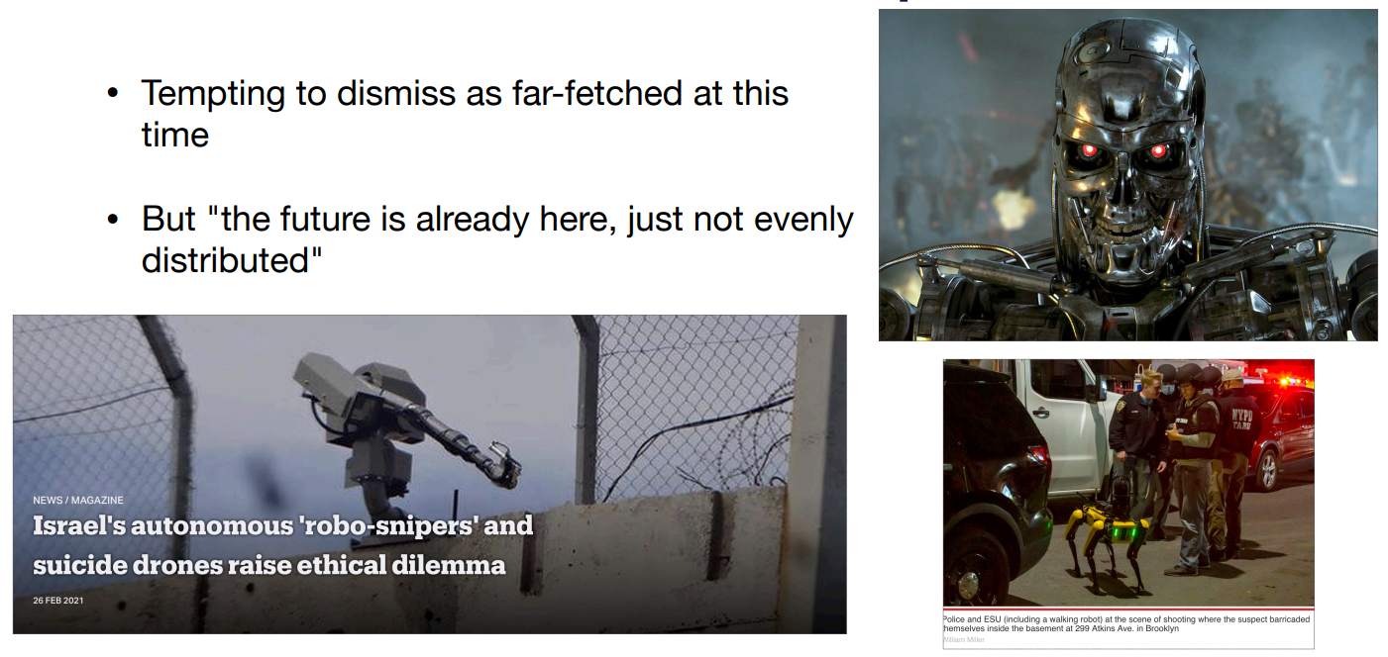
Long term Problem
Weapon

Slide 15
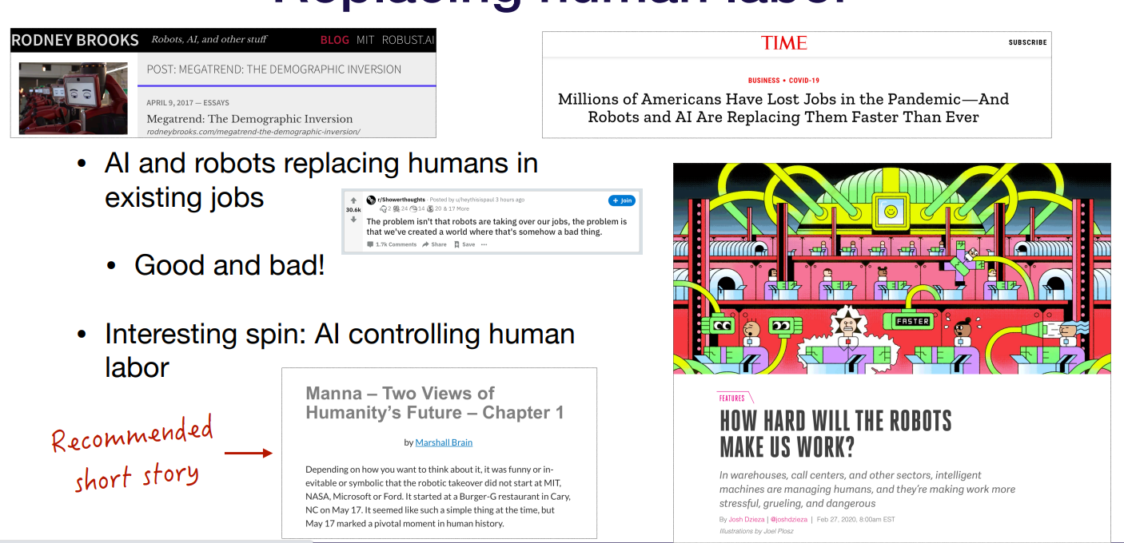
Long term Problem
Replacing human in labor

Slide 16
Long term Problem
Triggering question
What's common in all these
long-term problems?

Slide 17
Near Term Problem

Slide 18
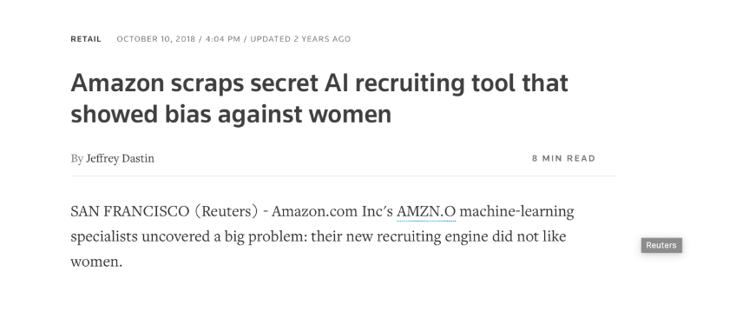
Near term Problem
Hiring Process

Slide 19
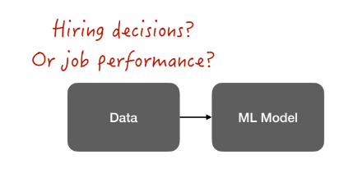
Near term Problem
Hiring Process

Slide 20
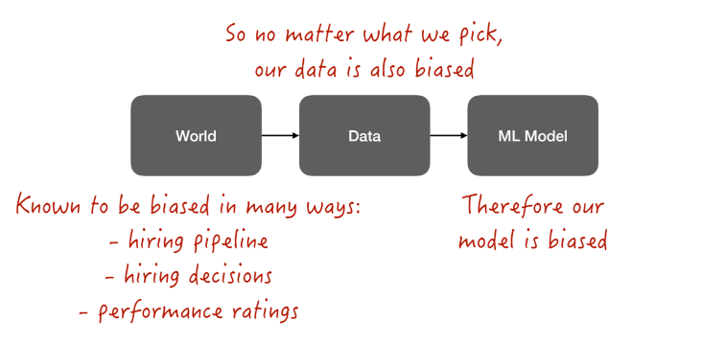
Near term Problem
Hiring Process

Slide 21
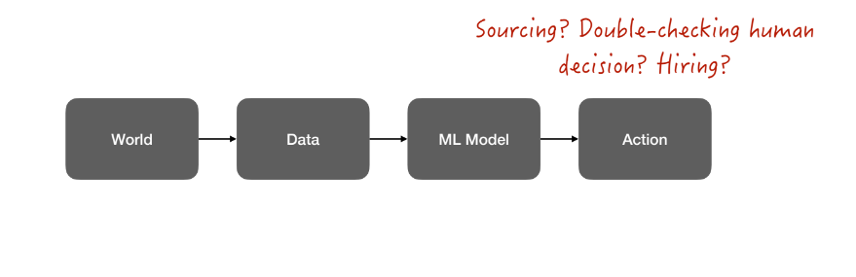
Near term Problem
Hiring Process

Slide 22
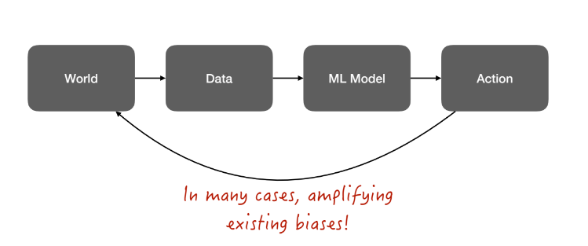
Near term Problem
Hiring Process

Slide 23
Topic on Ethical AI

Slide 24
Topic on Ethical AI
Learn to assess AI systems adversarially
Ethics of the research question
Impact of technology and potential dual use: Who could benefit from such a technology? Who can be harmed by such a technology? Could sharing data and models have major effect on people’s lives?
Privacy: Who owns the data? Published vs. publicized? User consent and implicit assumptions of users how the data will be used.
Bias in data: Artifacts in data, population-specific distributions, representativeness of data.
Social bias & unfairness in models: How to control for confounding variables and corner cases? Does the system optimize for the “right” objective? Does the system amplify bias?
Utility-based evaluation beyond accuracy: FP & FN rates, “the cost” of misclassification, fault tolerance.

Slide 25
Topic on Ethical AI
Social Issues
Social bias and algorithmic fairness: social bias in data & AI models
Privacy violation: Privacy violation & language-based profiling
Incivility: Hate-speech, toxicity, incivility, microaggressions online
Misinformation: Fake news, information manipulation, opinion manipulation
Technological divide: Unfair technologies underperforming for speakers of minority dialects, for languages from developing countries, and for disadvantaged populations
Environmental impacts of AI models

Slide 26
Best Practice

Slide 27
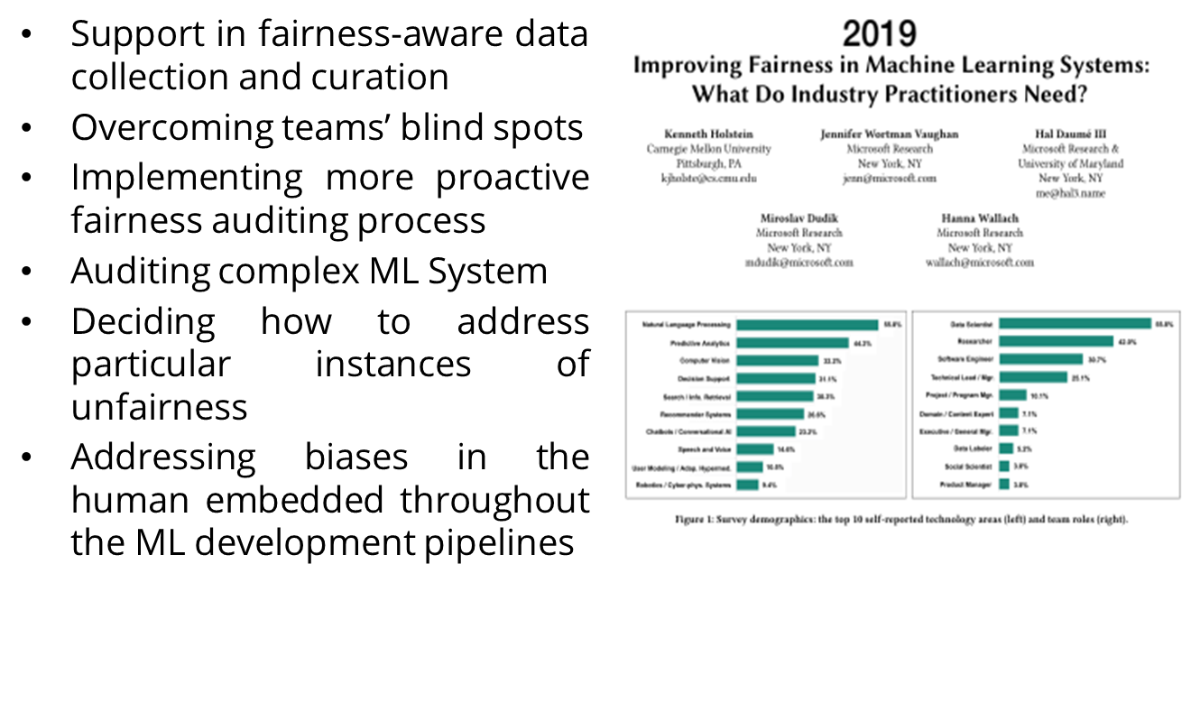
Best Practice
Hiring

Slide 28
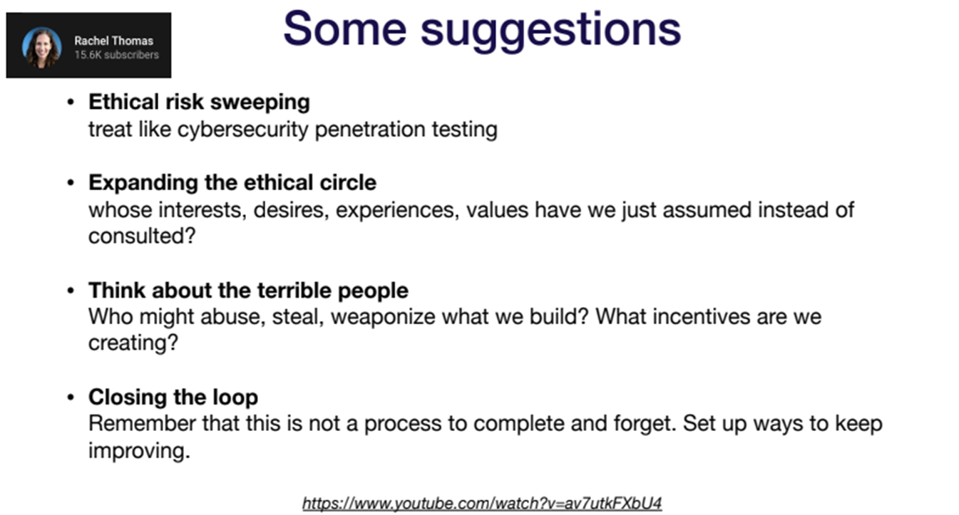
Best Practice
Hiring

Slide 29
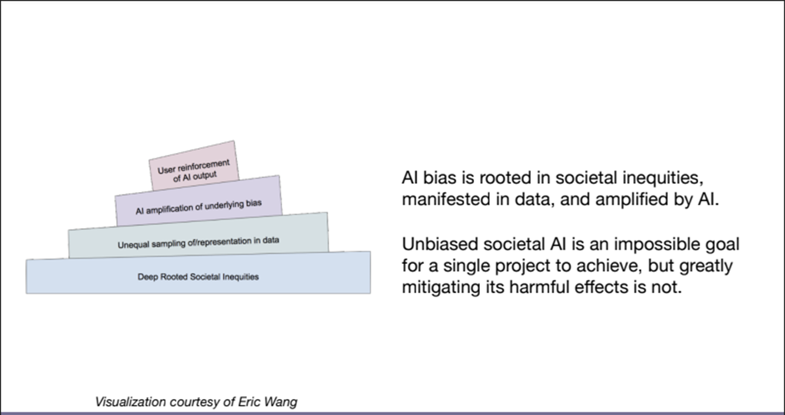
Best Practice
Hiring

Slide 30
Exercise

Slide 31
Exercise
Session 18
How can we prevent AI from inheriting human biases in decision-making?

Slide 32
References

Slide 33
References
Session 17
N. Bostrom and E. Yudkowsky. (2014) ‘The ethics of artifcial intelligence’. In W. M. Ramsey and K. Frankish, editors, The Cambridge Handbook of Artificial Intelligence, pages 316–334. Cambridge University Press, Cambridge, 2014.
Sergey Karagev, Josh Tobin, Pieter Abbeel (2021) Ethics- Lecturer Notes: Full stack Deep Learning, University of California Berkeley.
Tsvetkov, Y. (2023). Introduction. Ethics in Artificial Intelligence. https://courses.cs.washington.edu/courses/cse582/23sp/

